Slide 1
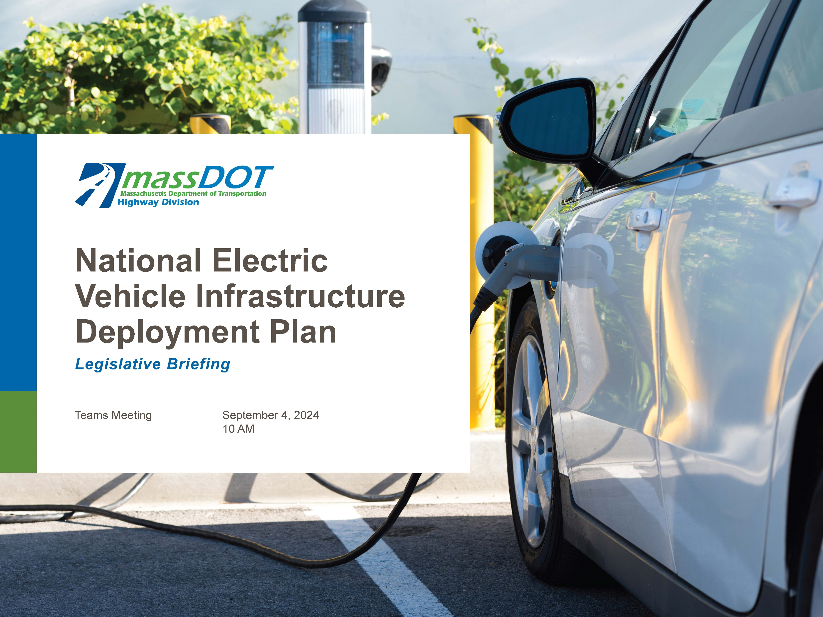
ABC EVSE Update
Chris Aiello & Andy Paul
October 29, 2024

Slide 2
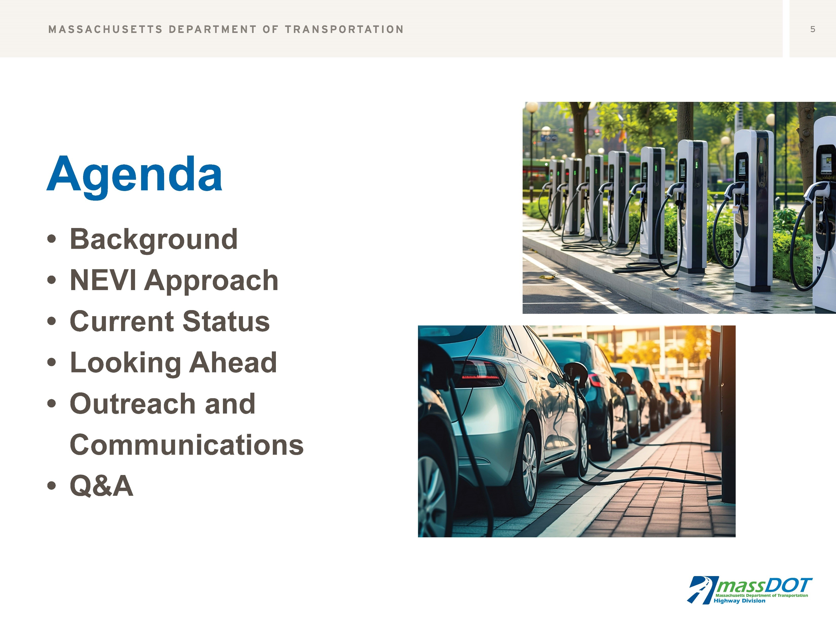

Slide 3
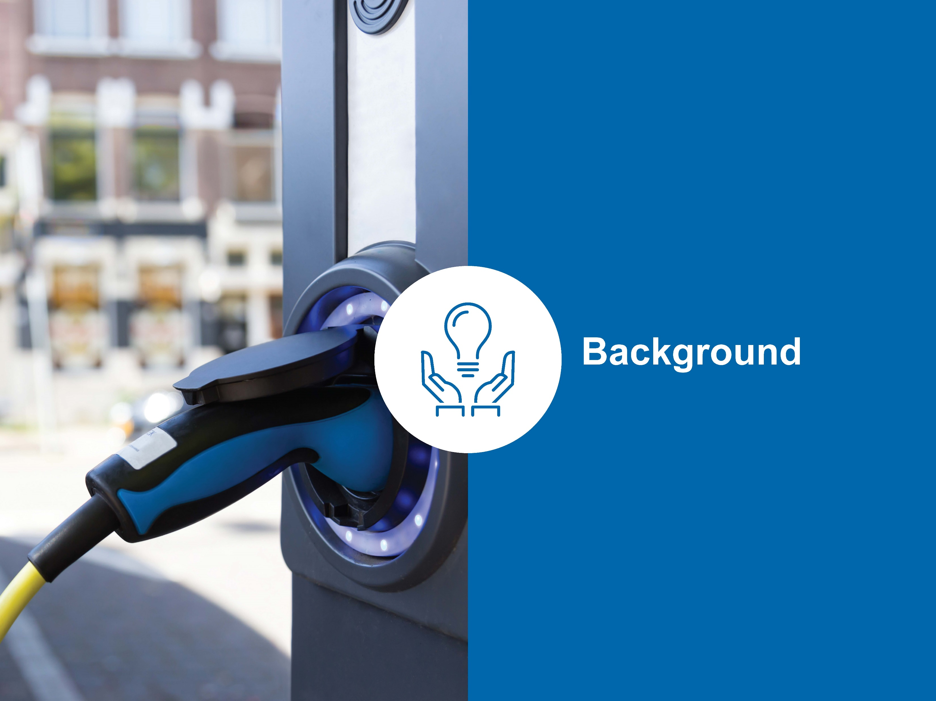

Slide 4
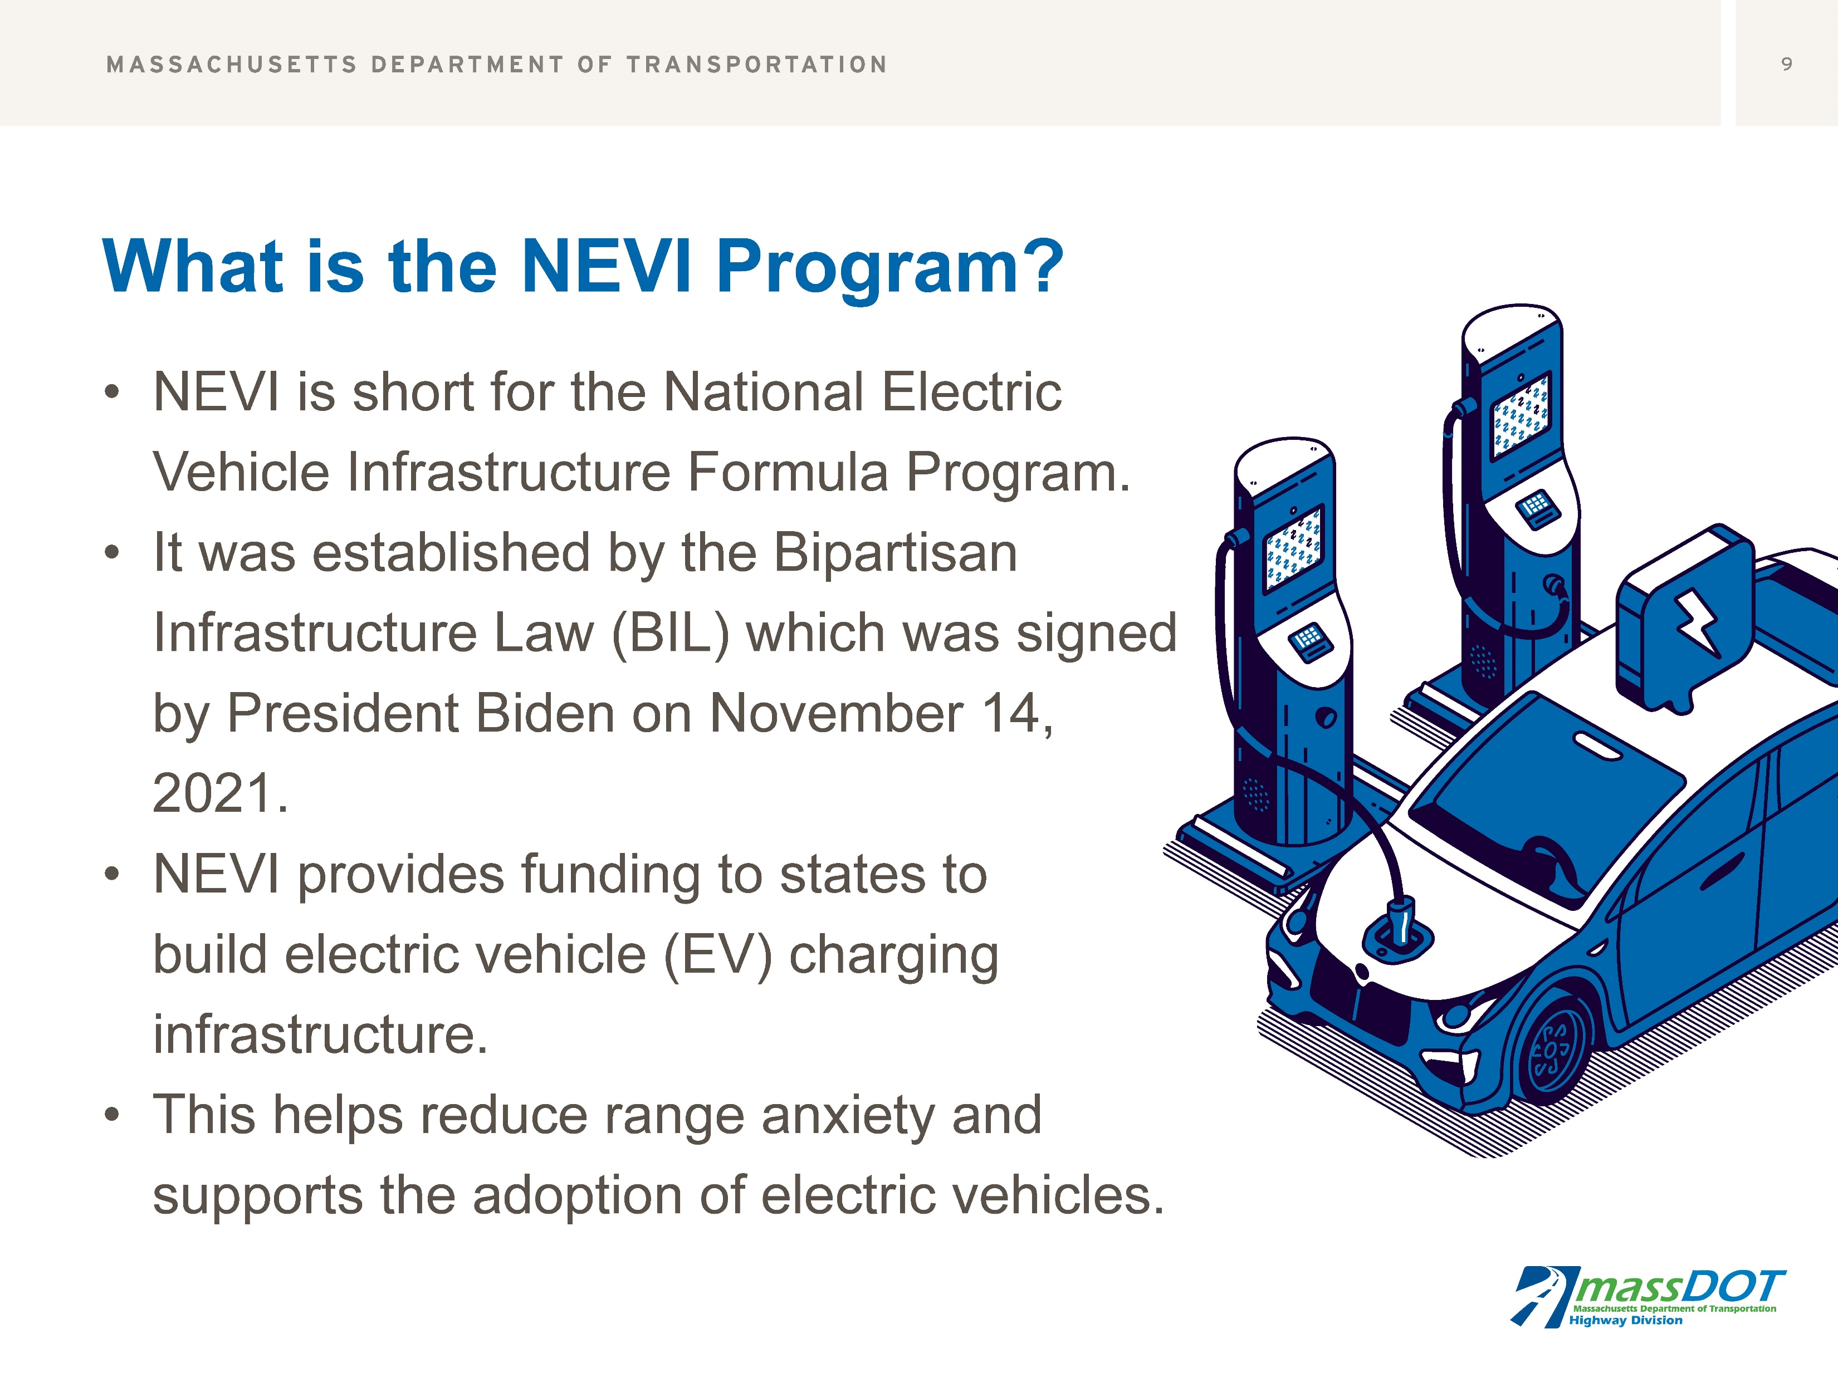

Slide 5
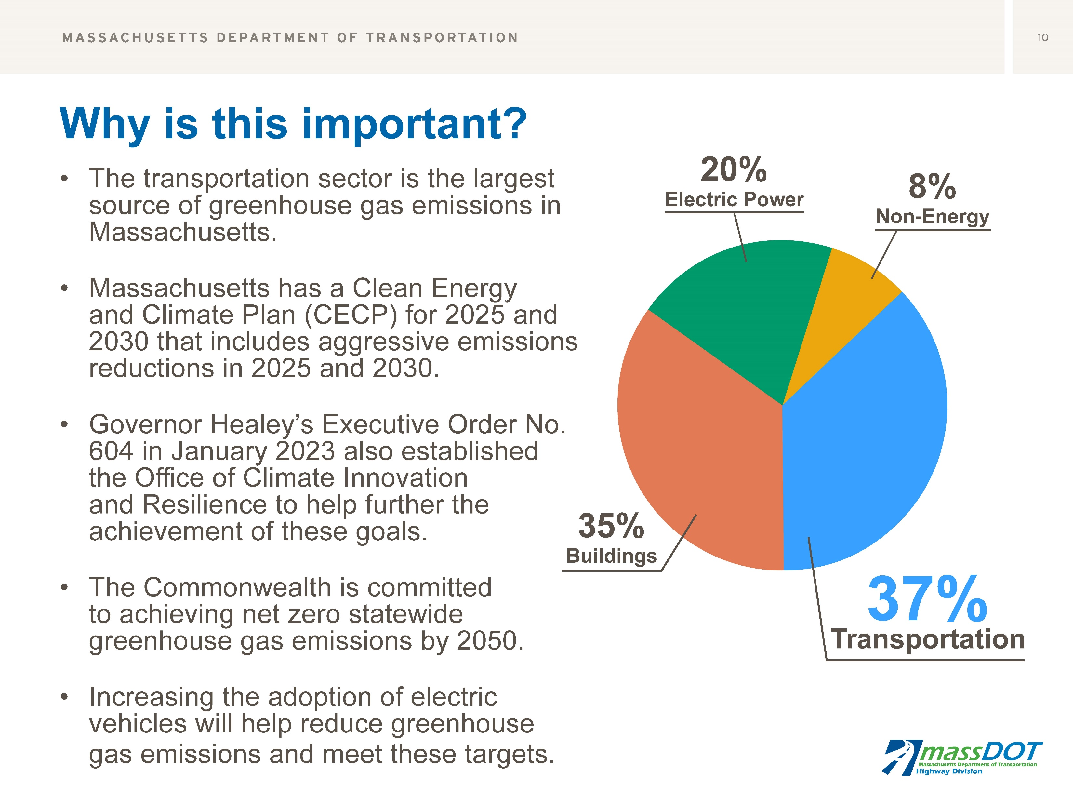

Slide 6
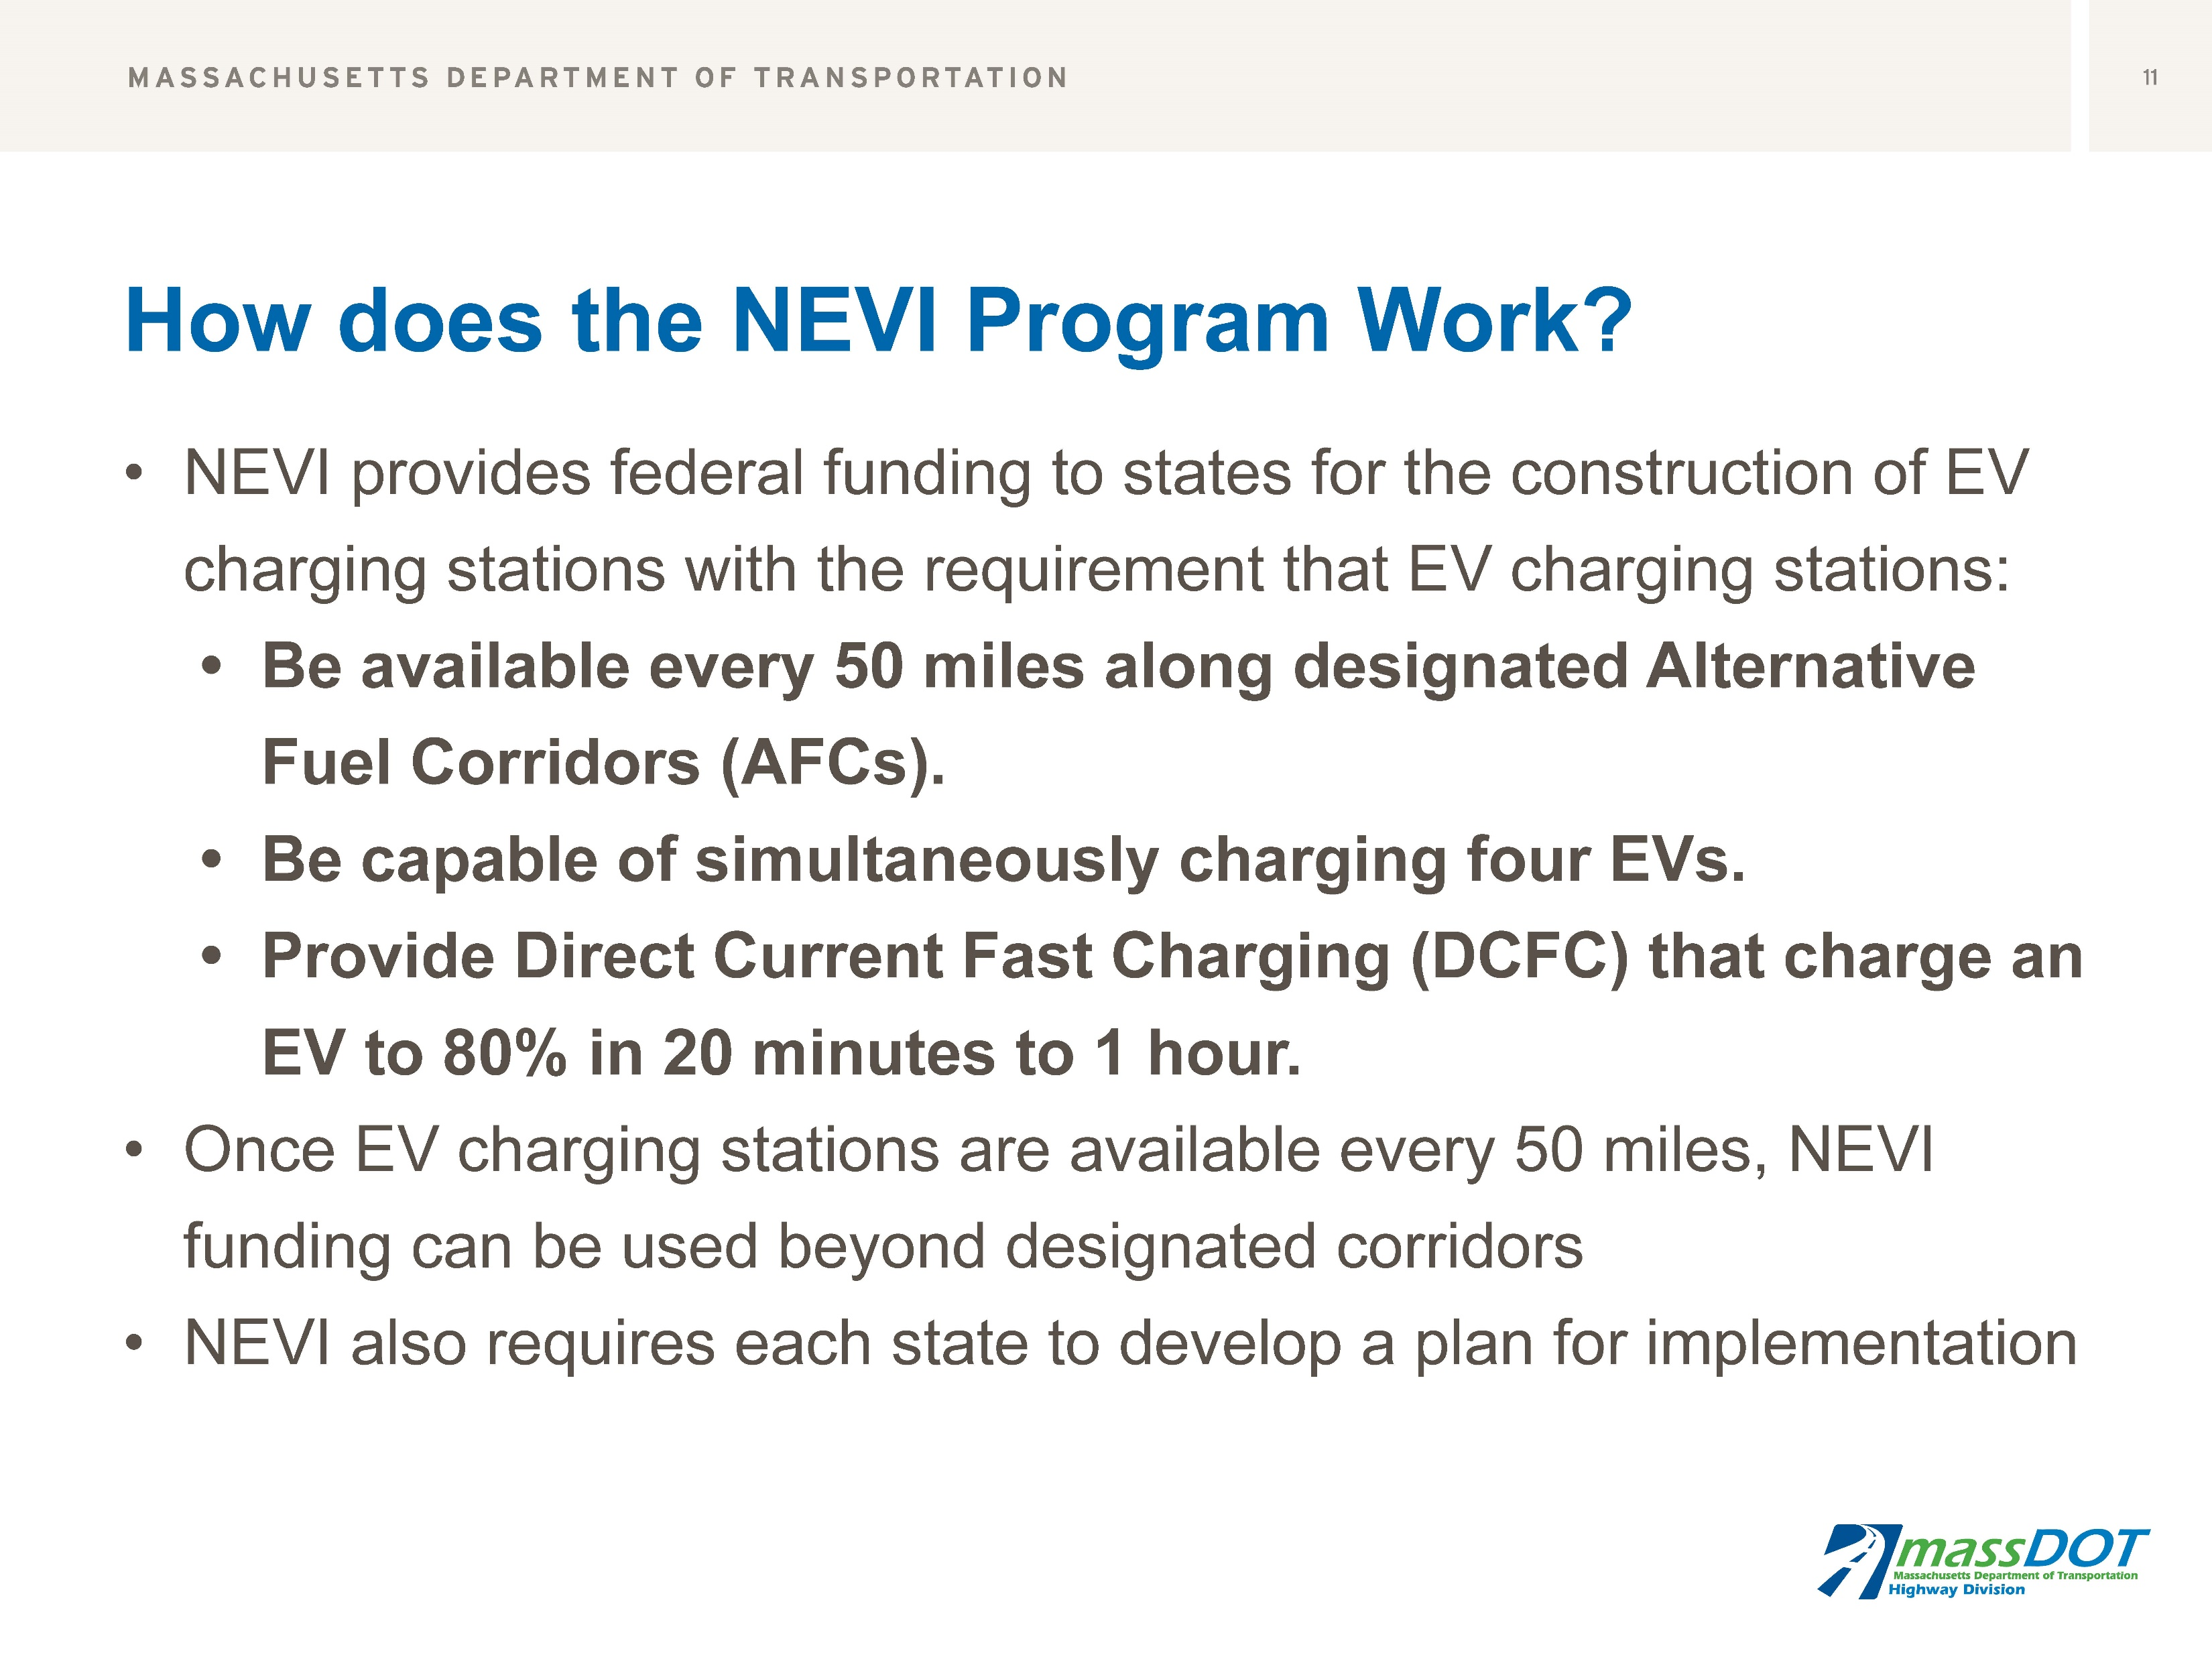

Slide 7
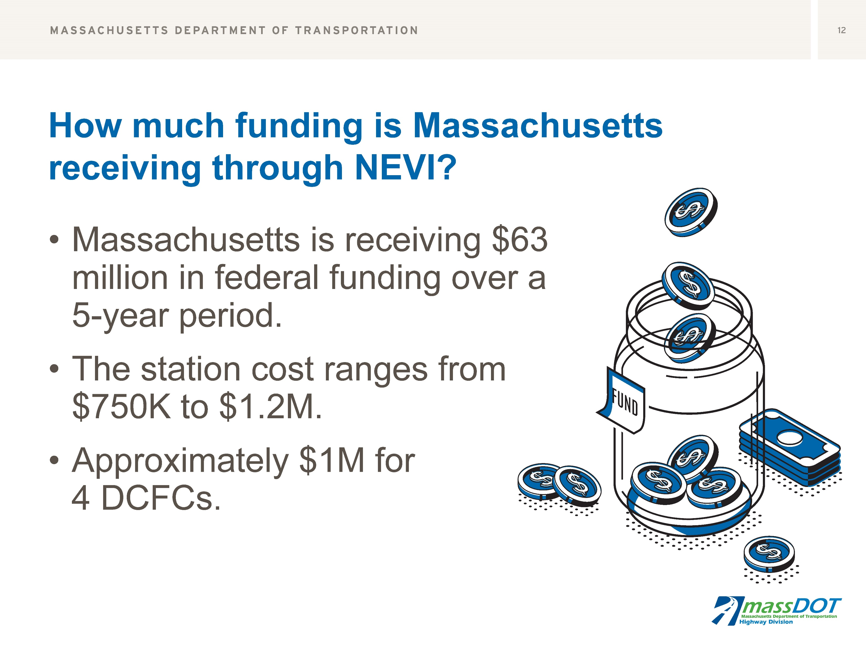

Slide 8
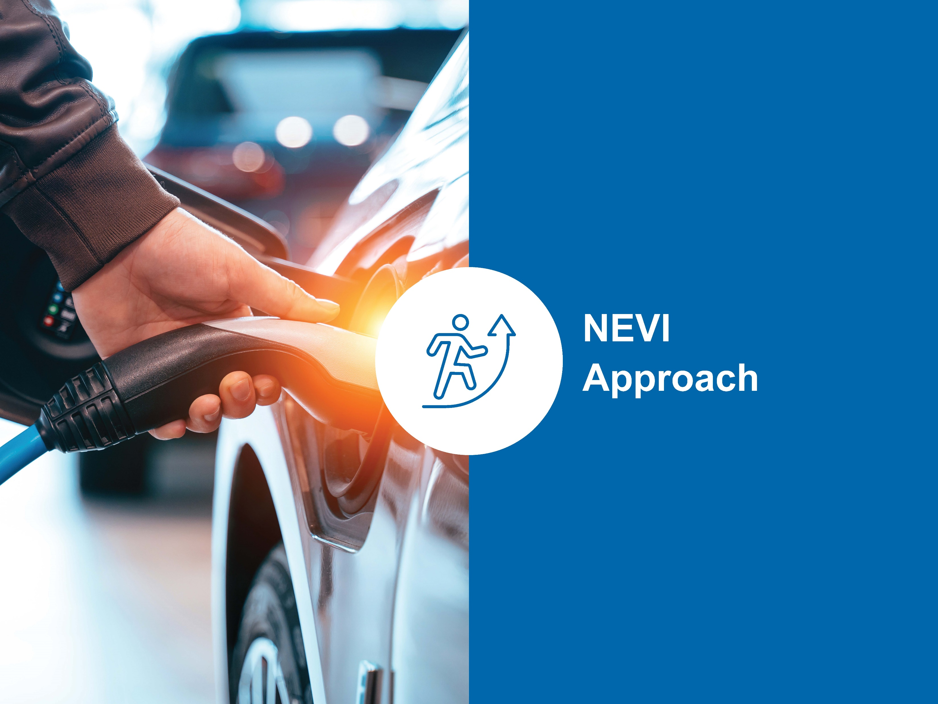

Slide 9
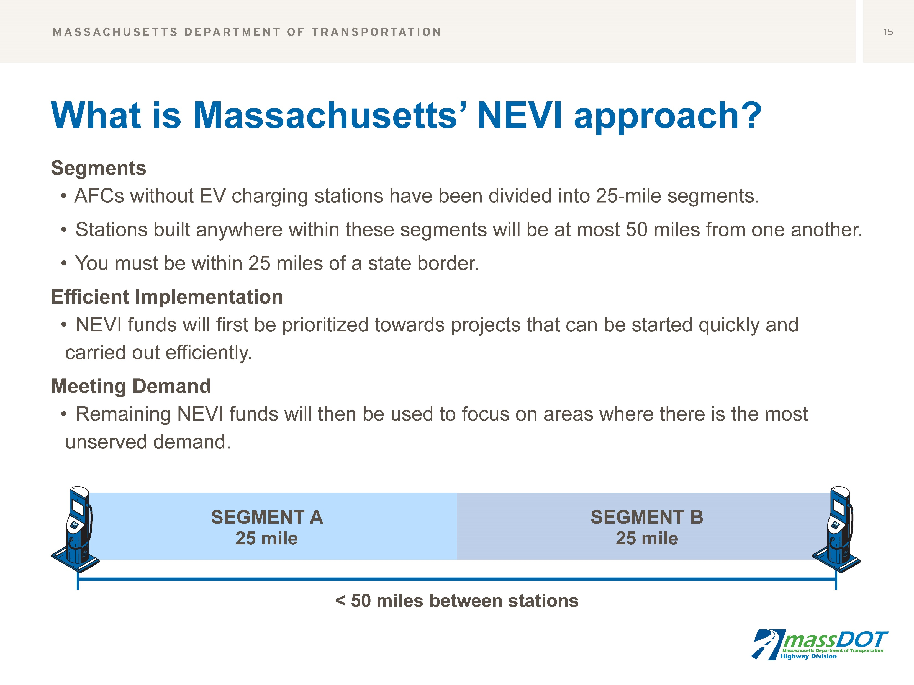

Slide 10
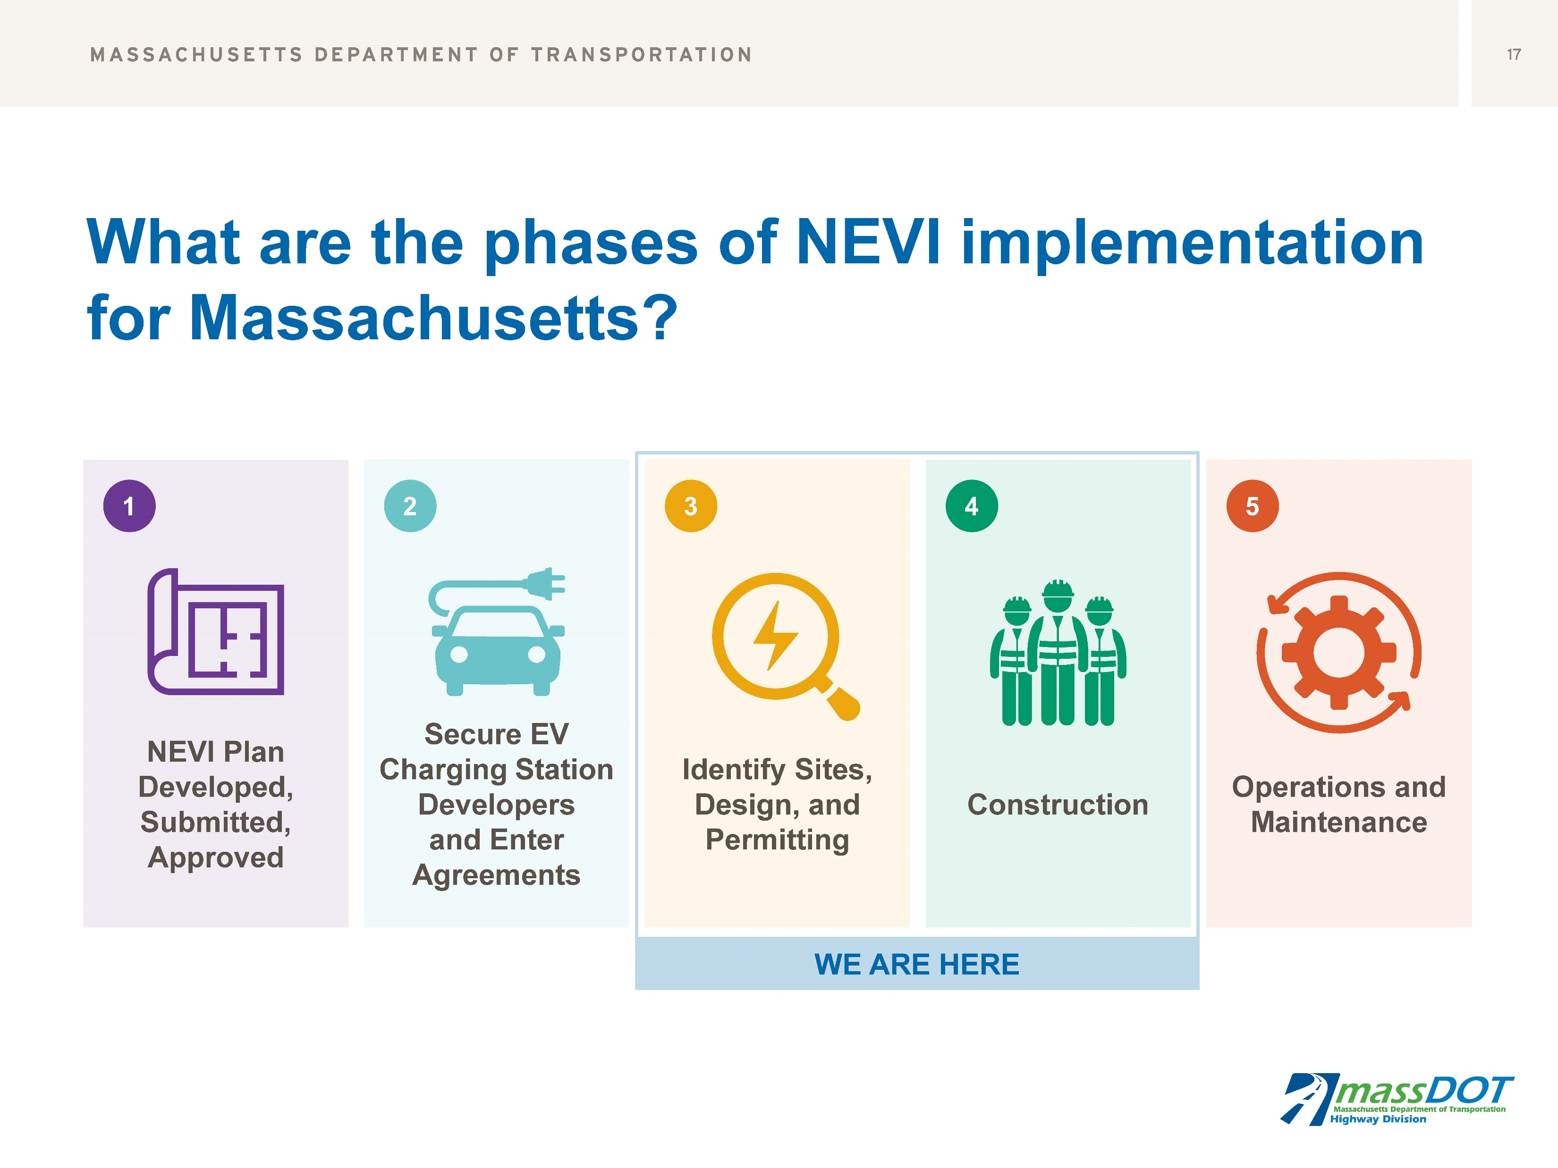

Slide 11
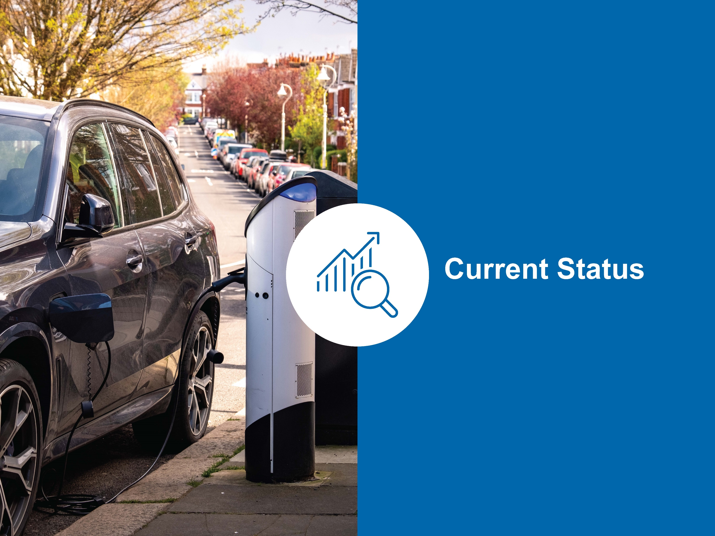

Slide 12
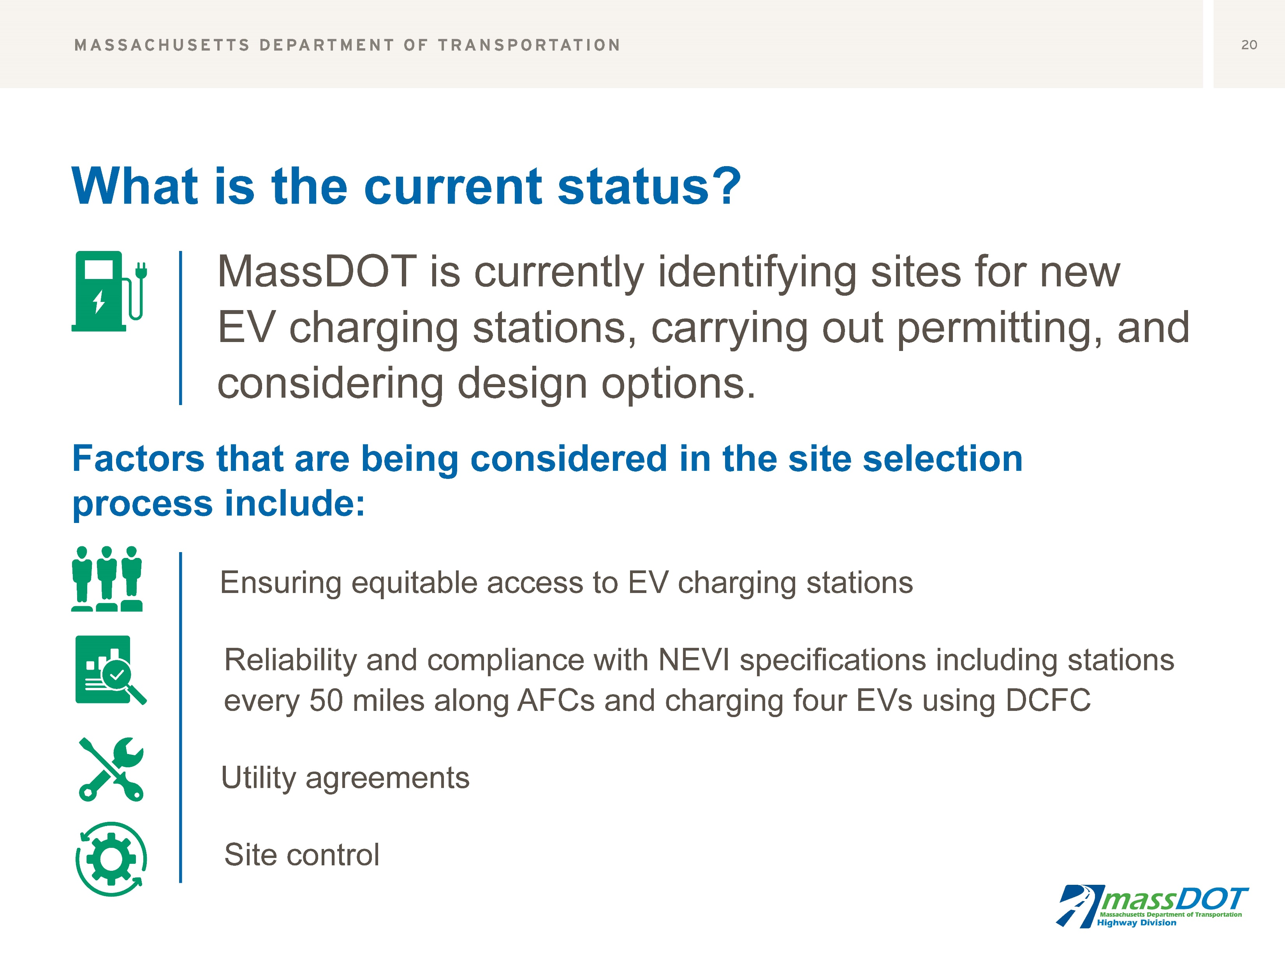

Slide 13
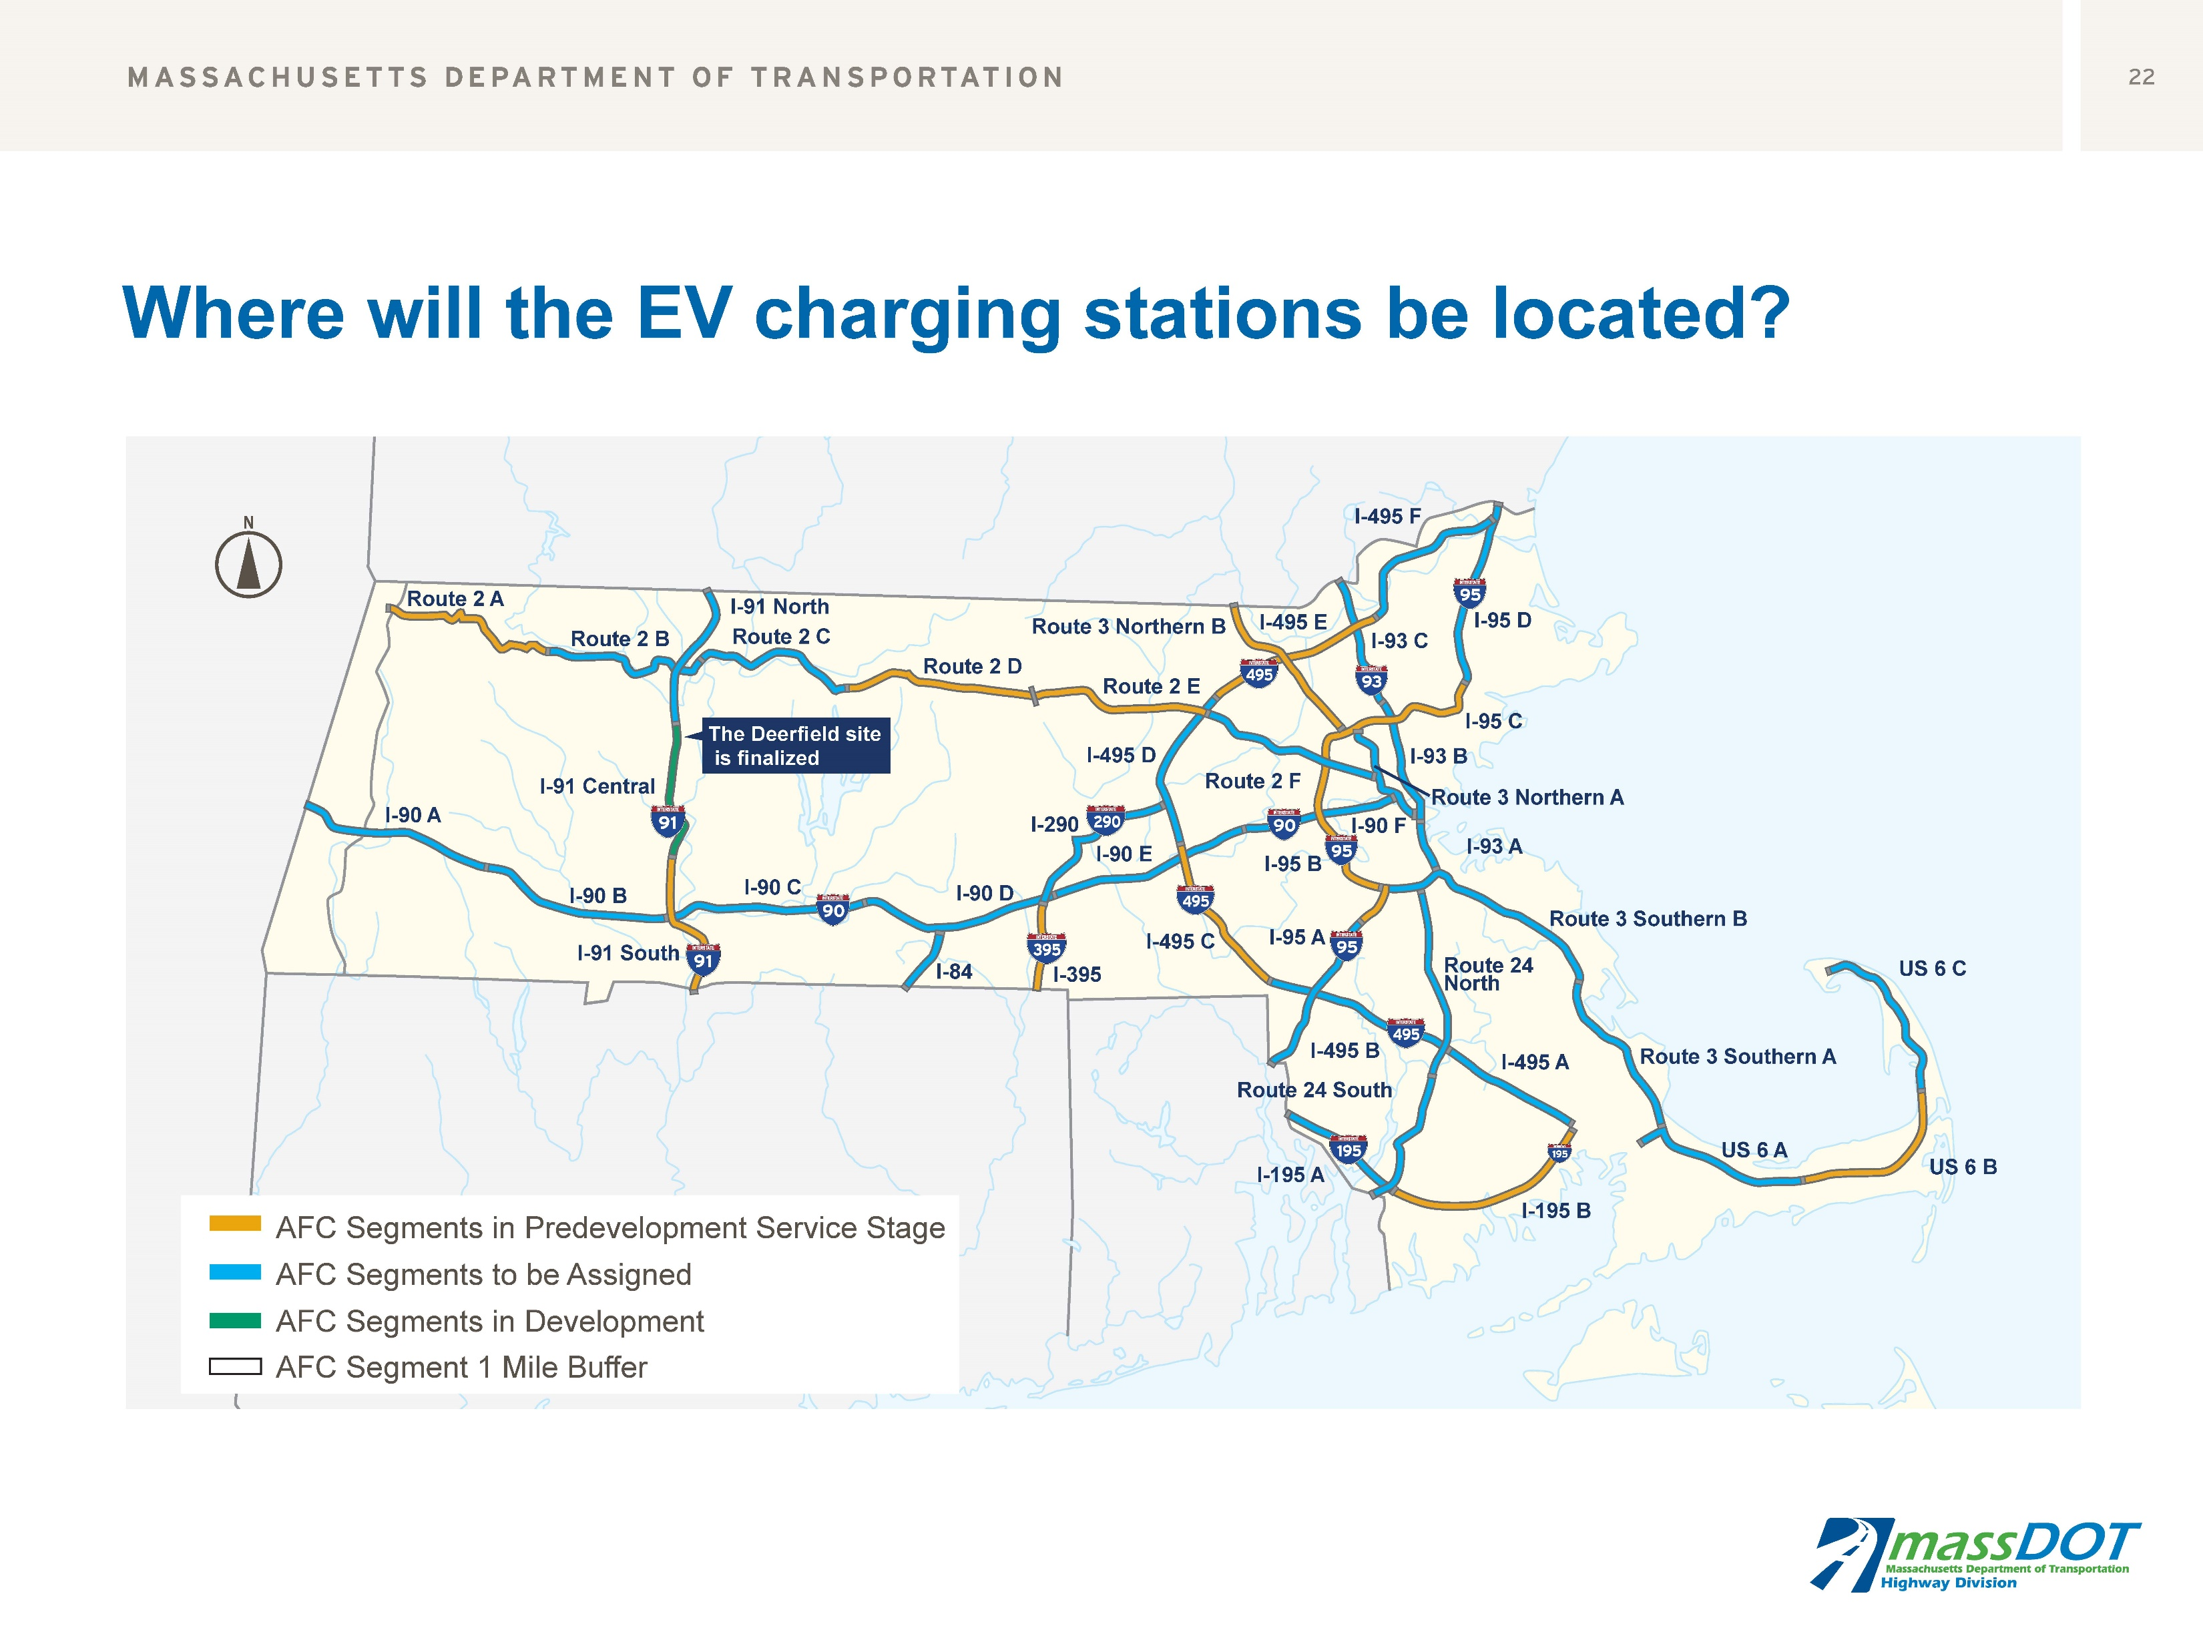

Slide 14
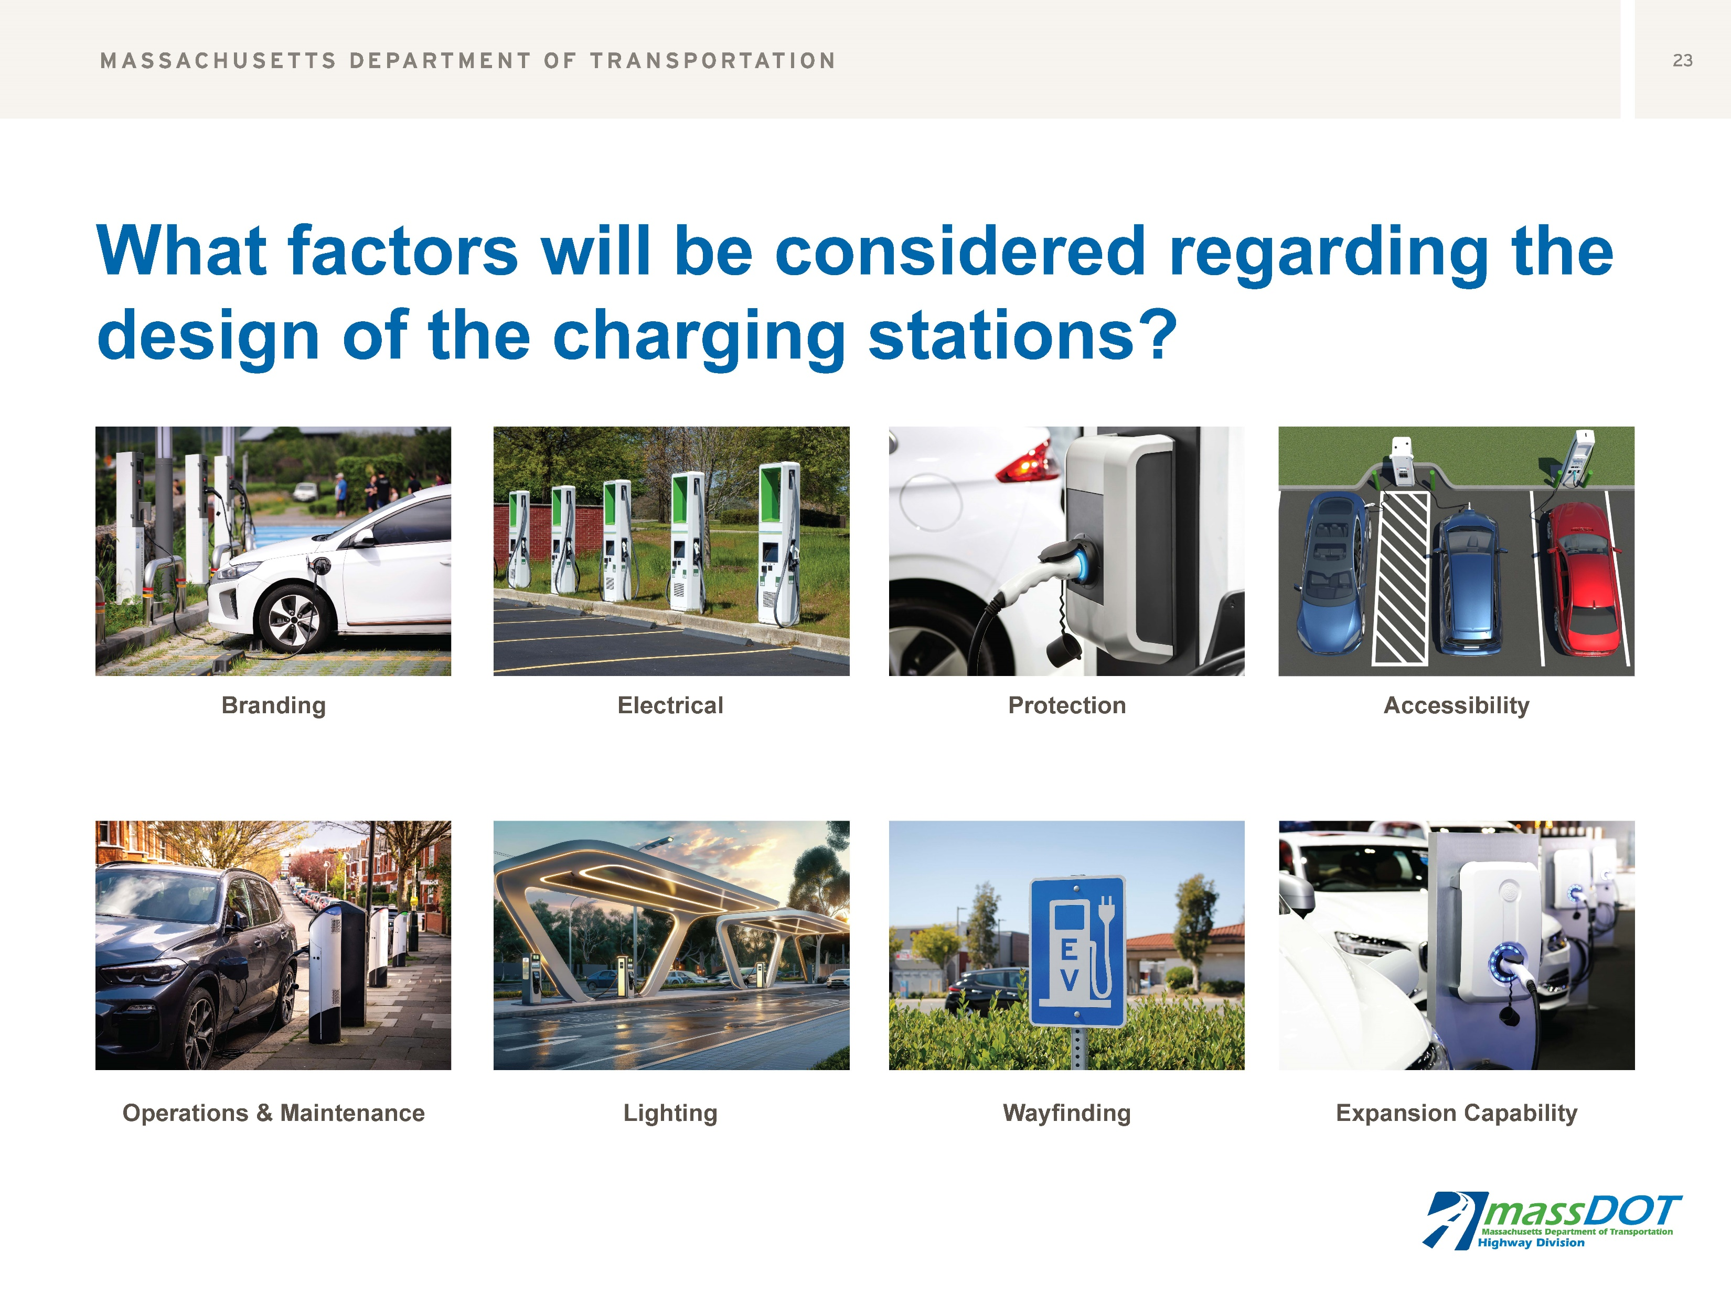

Slide 15
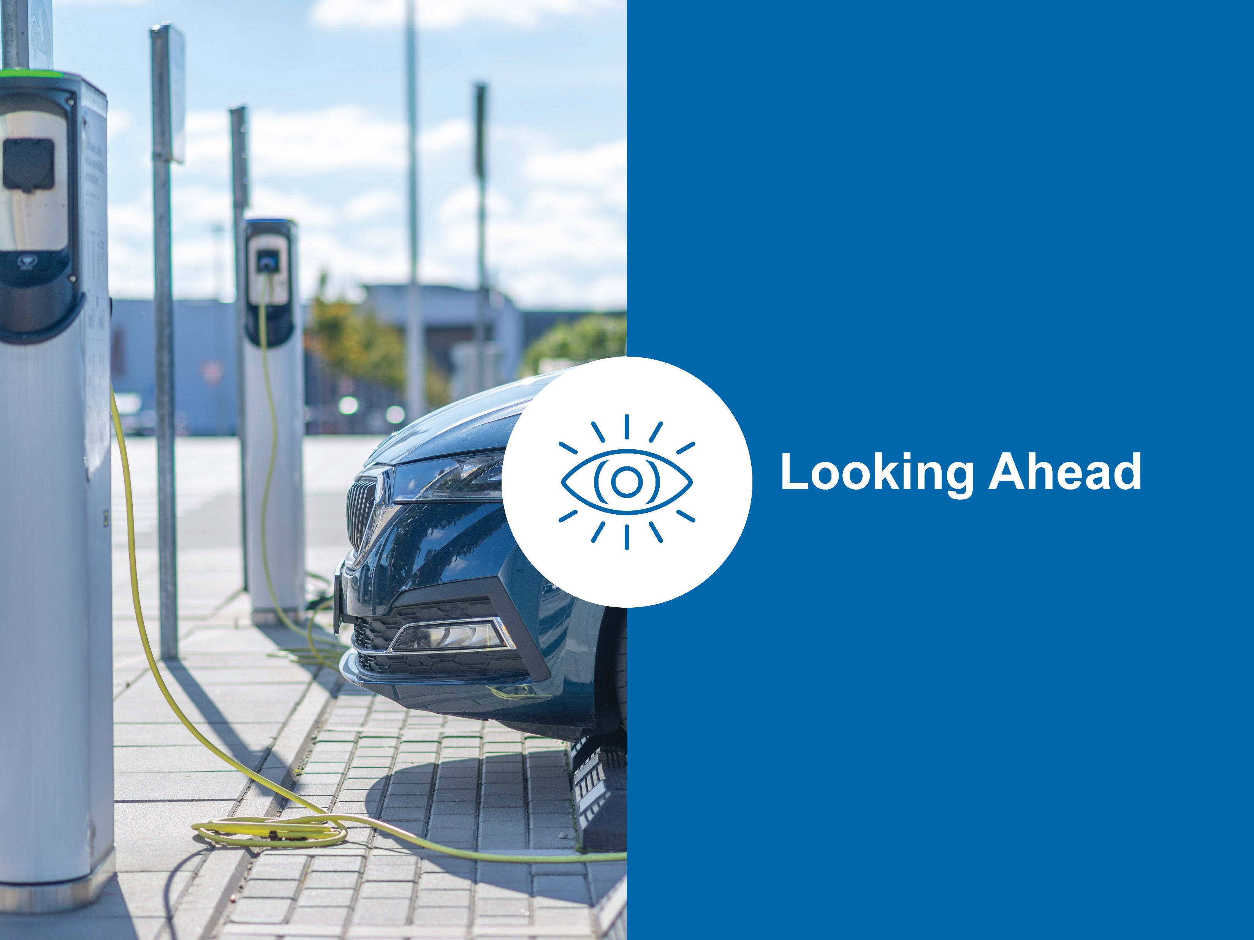

Slide 16
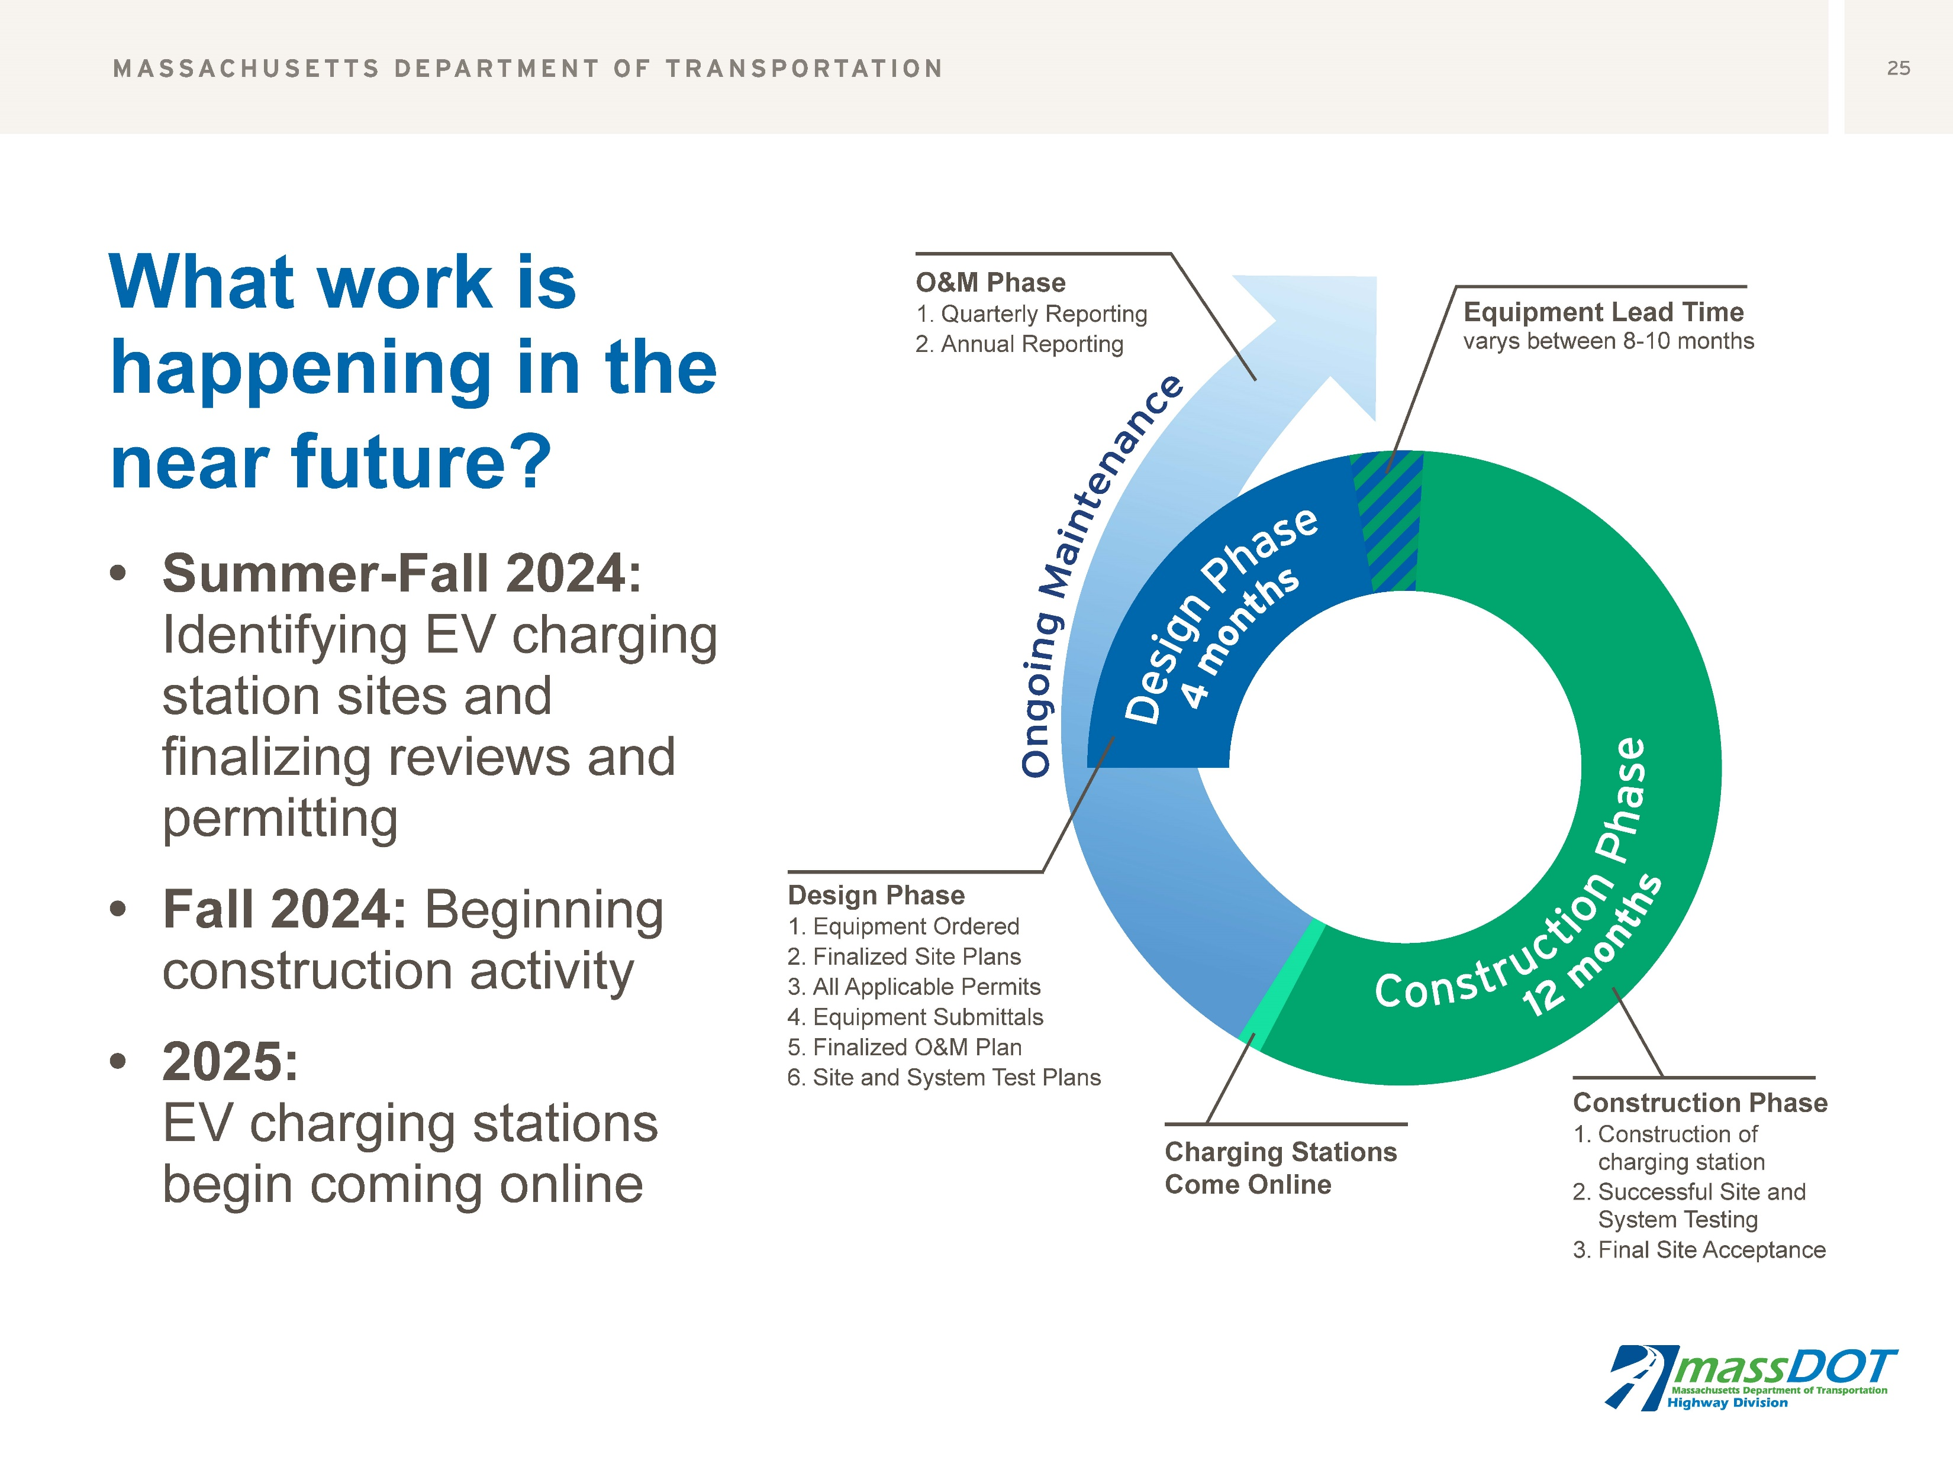

Slide 17


Slide 18
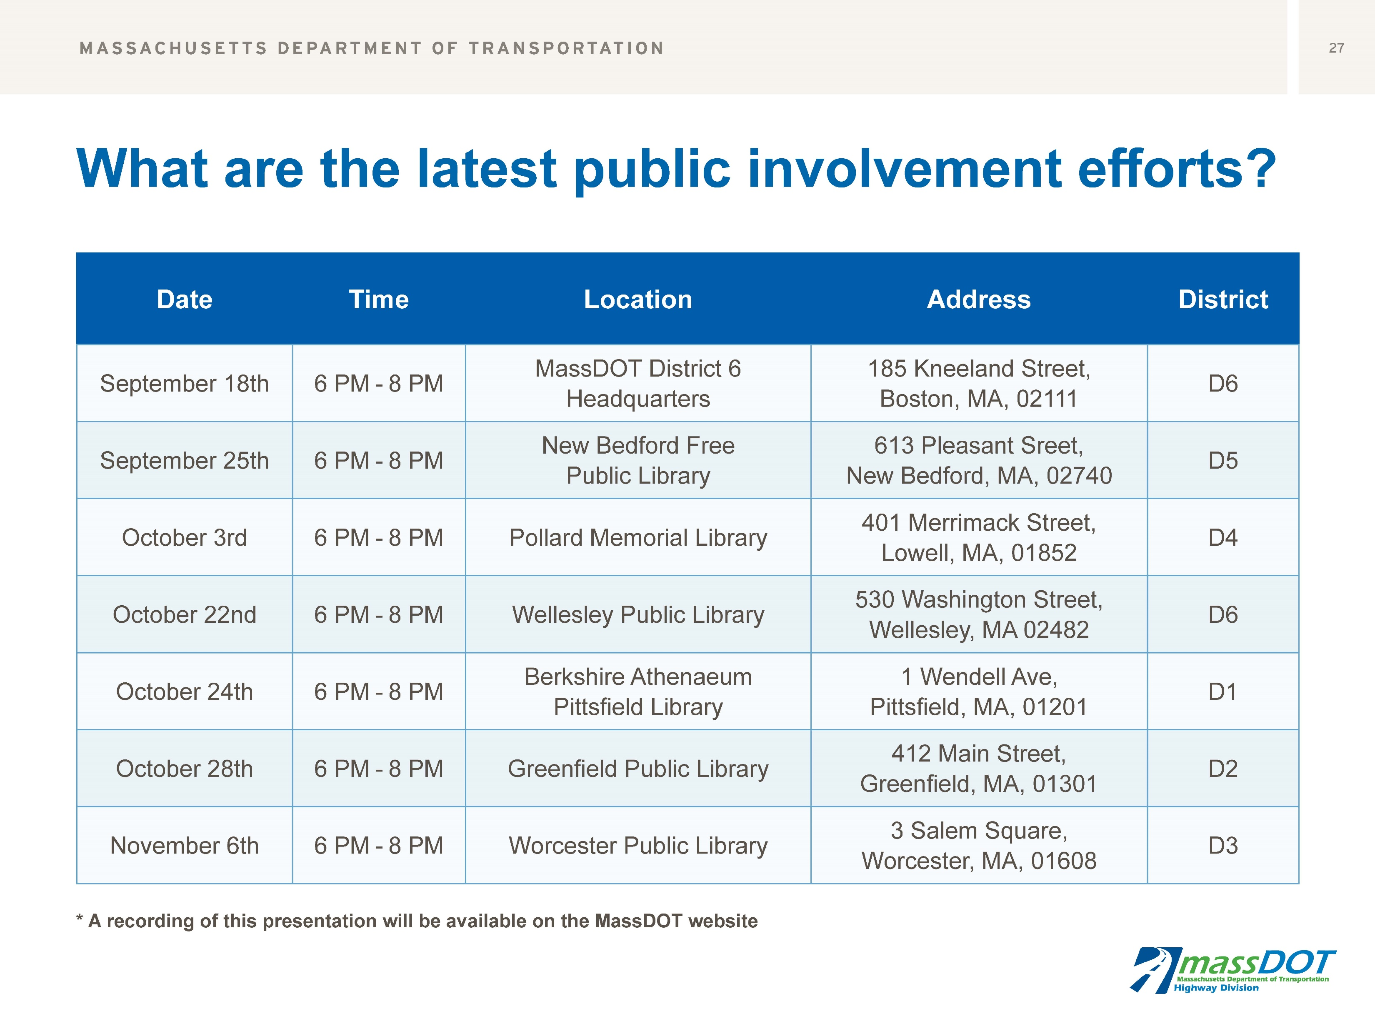

Slide 19
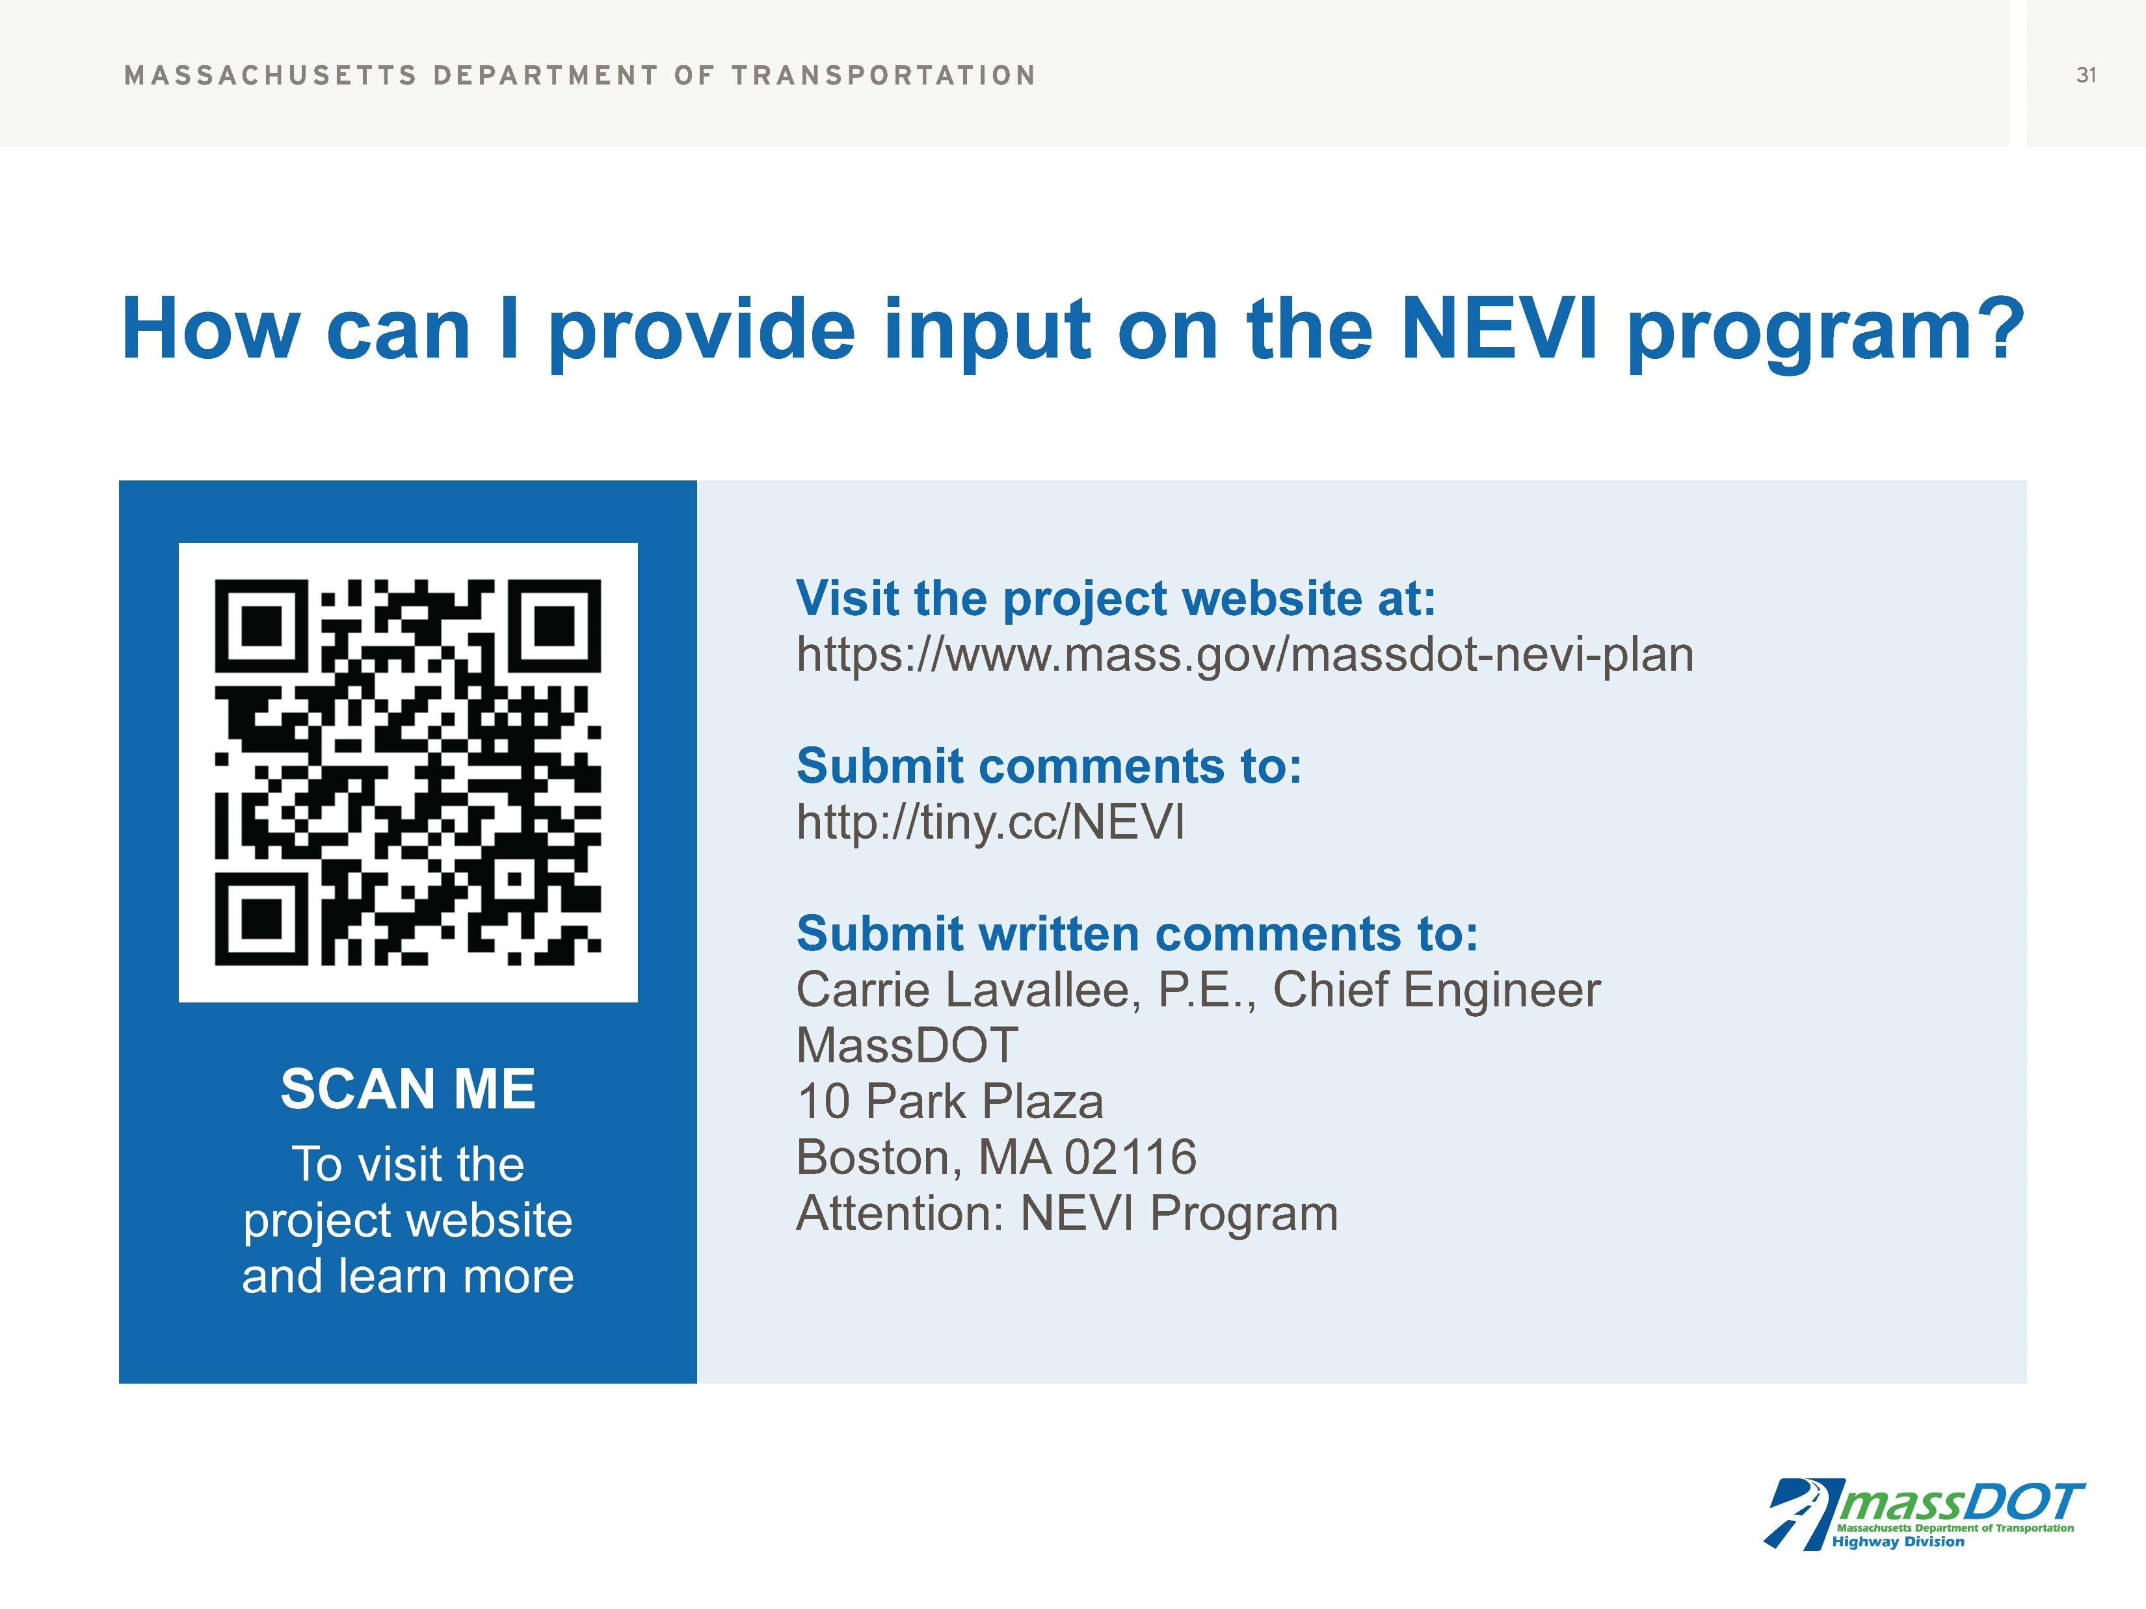

Slide 20

MassDOT EVSE CFI Grant Overview

Slide 21

MassDOT & MBTA CFI Round 2 Grant Application
4
MassDOT submitted a joint application with MBTA
  $800 million in total funding available
  Requesting $14.4 Million in Funding over 5 years out of a total of $18 million
  MassDOT CFI Program Vision: Promote EV adoption, both passenger and fleet
Emphasis on Multimodal Hubs
 | Number of Locations | Level 2 Ports | Level 3 Ports
MBTA Rapid Transit Station | 8 | 127 | 0
MBTA Commuter Ferry Station | 2 | 15 | 0
MBTA Commuter Rail | 14 | 205 | 0
MassDOT Park and Ride Facilities | 6 | 111 | 14
Total | 30 | 458 | 14

Slide 22
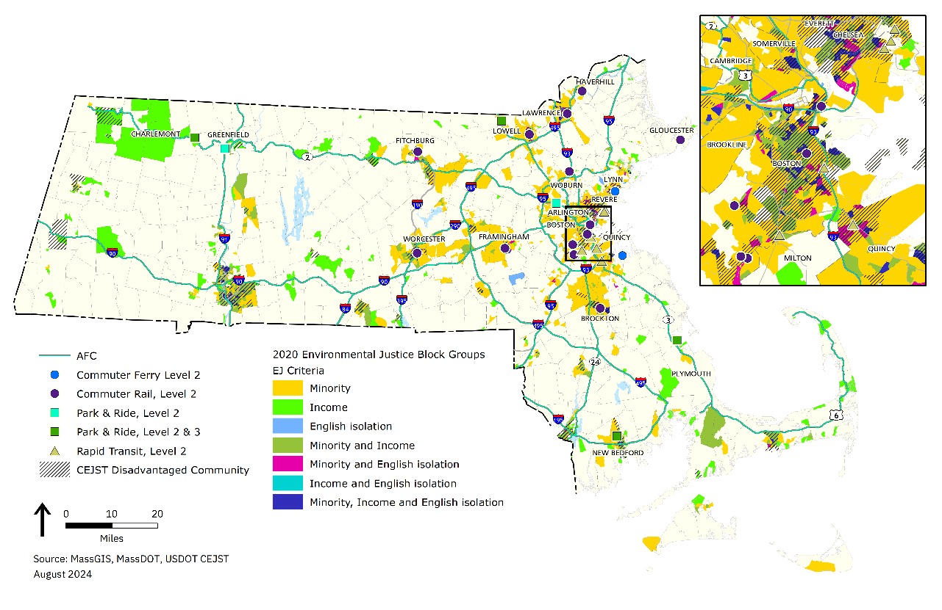
CFI Grant: Potential Locations
5
Massachusetts Environmental Justice (EJ) and Climate Equity and Justice Screening Tool (CEJST) communities
  77% of new ports to be located within EJ communities
  Public engagement with EJ communities online and through local community organizations
Presence of multi-unit housing near project locations

Slide 23
